Slide 1



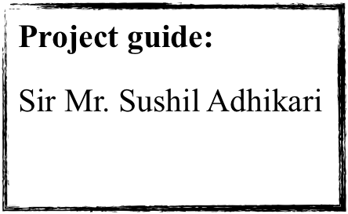
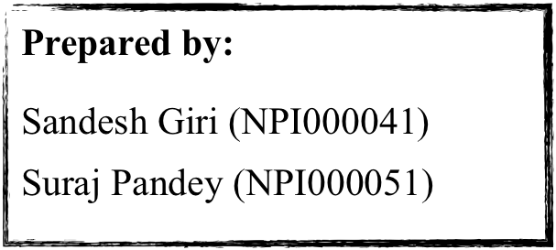
Object Oriented Programming with Java(CT038 3 -2)
Presentation on
Courier Management System

Slide 2


TABLE OF CONTENT
Introduction
Objective
UML Diagram
Class Diagram
Use Case Diagram
User Roles
Use of Object Oriented Programming Language
Advantages of Object Oriented System
Limitations
Conclusion
References

Slide 3
Introduction
Our project is developed under java programming language
System can handle user account management, order management, view report and feedback management.
Data are stored in txt files.

Slide 4

Objective
To manage details of customer, delivery staff, orders, invoice report.
To reduce the manual working

Slide 5

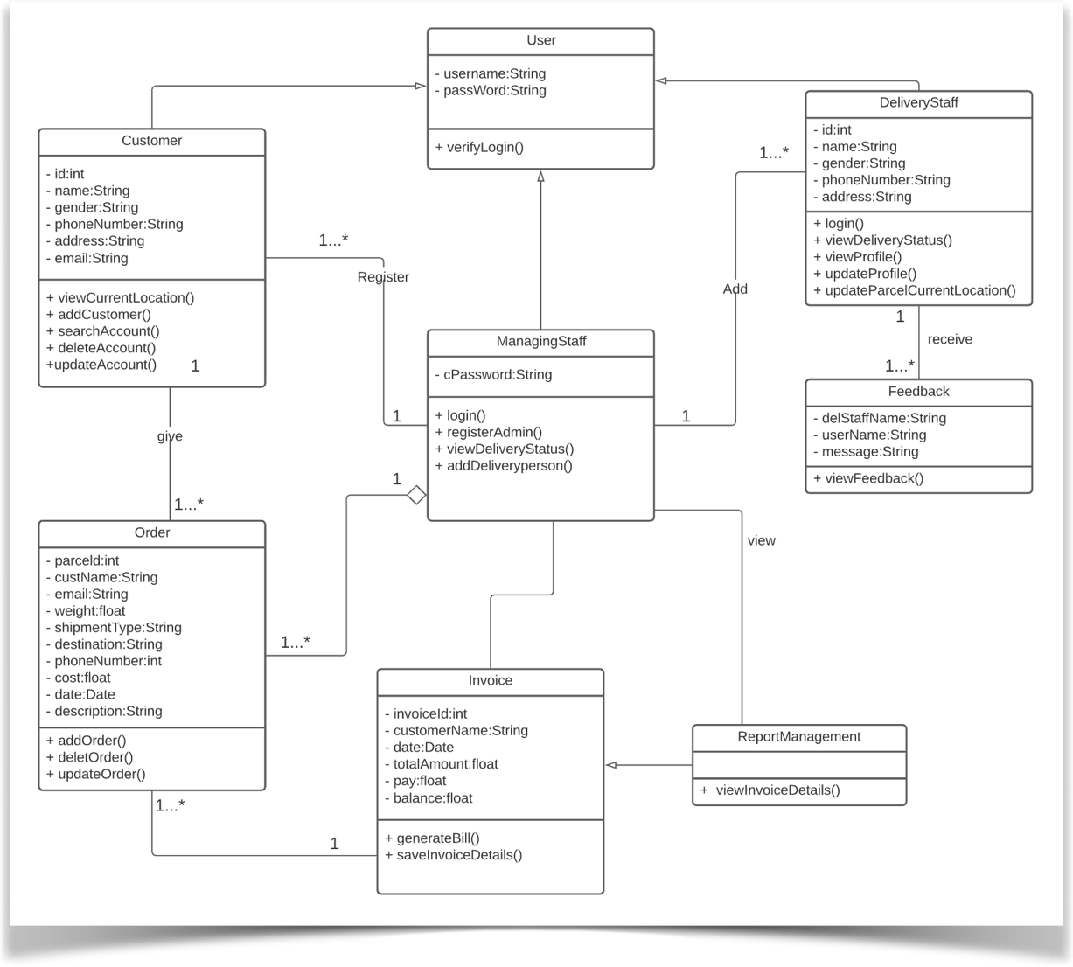
Class Diagram

Slide 6

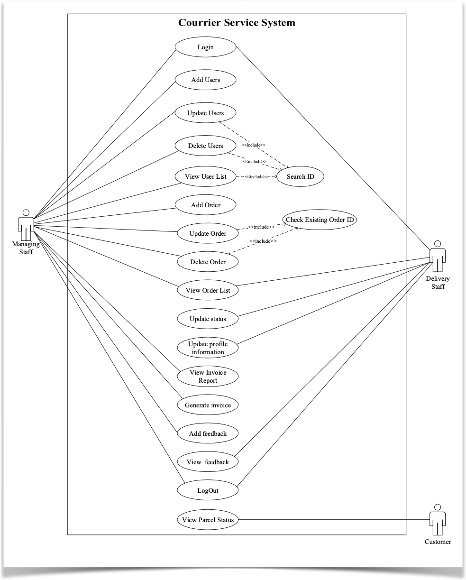
Use Case Diagram

Slide 7




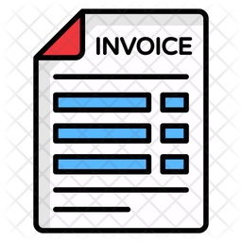


User Role
Managing Staff Roles
Manage User Account
Manage Order
Generate Invoice
View Invoice Report
Send Feedback

Slide 8

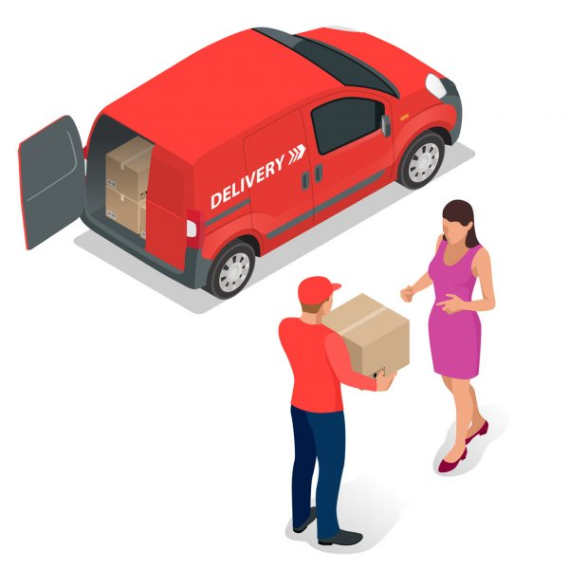




User Role
Delivery Staff Roles
View Delivery Status
Update Parcel current location
View Personal Profile
Update Profile

Slide 9

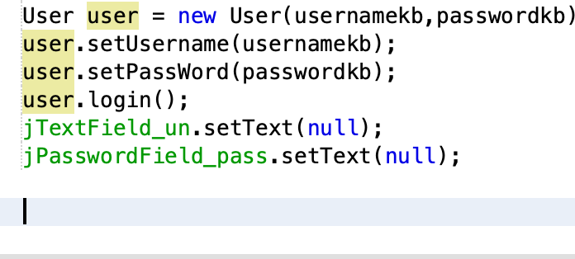
Use of Object Oriented Programming Concept
Creation of class and object

Slide 10
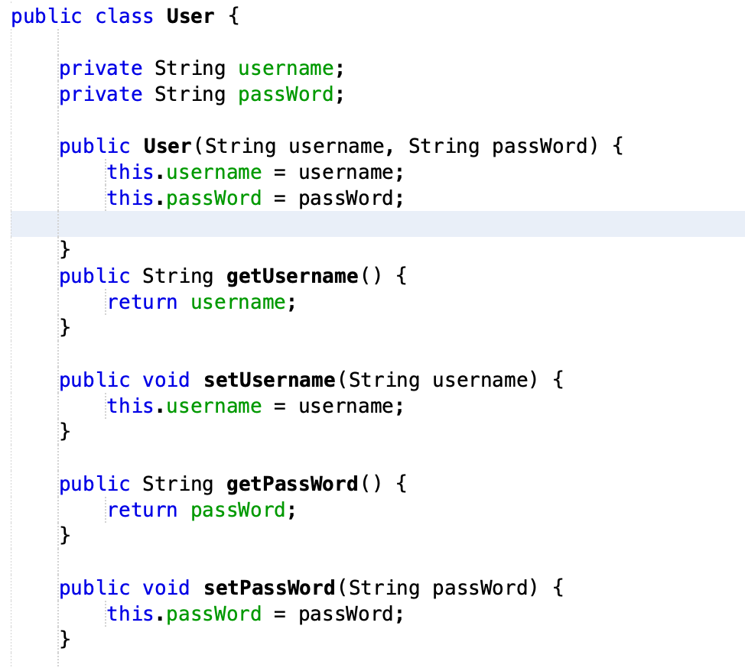
Use of Object Oriented Programming Concept
Encapsulation

Slide 11
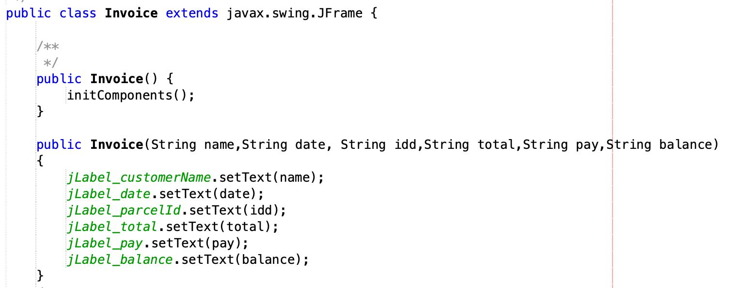
Use of Object Oriented Programming Concept
Constructor

Slide 12
Use of Object Oriented Programming Concept
Inheritance

Slide 13
Advantages of Object Oriented System
Code Reusability through inheritance
Flexible due to the use of polymorphism
Simple
Fast development of software
Reduce maintenance.

Slide 14
Limitations
Cannot delete and update feedback.
Data related to the customer are not deleted when customer account is deleted from the file.
Can only view invoice report stored in file(cannot view weekly, monthly and annual report separately).
Delivery staff can view all the orders.

Slide 15
Conclusion
System is developed under OOP concept by the creation of class, object, inheritance, constructor and encapsulation.
Software that is used to code this system was Netbeans.
The targeted users are managing staff and delivery staff.

Slide 16


References
ALTVATER, A. (2020). What Are OOP Concepts in Java? The Four Main OOP Concepts in Java, How They Work, Examples, and More. Retrieved 8 August 2021, from https://stackify.com/oops-concepts-in-java/
Capka, D. (2021). Lesson 7 - Inheritance and polymorphism in Java. Retrieved 10 August 2021, from https://www.ictdemy.com/java/oop/inheritance-and-polymorphism-in-java
Encapsulation in Java - GeeksforGeeks. (2021). Retrieved 9 August 2021, from https://www.geeksforgeeks.org/encapsulation-in-java/
Gills, A., & Lewis, S. (2021). What is Object-Oriented Programming (OOP)?. Retrieved 8 August 2021, from https://searchapparchitecture.techtarget.com/definition/object-oriented-programming-OOP
Inheritance in Java - GeeksforGeeks. (2021). Retrieved 7 August 2021, from https://www.geeksforgeeks.org/inheritance-in-java/
Java - Constructors. (2021). Retrieved 11 August 2021, from https://www.tutorialspoint.com/java/java_constructors.htm
Polymorphism in Java - javatpoint. (2021). Retrieved 10 August 2021, from https://www.javatpoint.com/runtime-polymorphism-in-java

Slide 17
Work Division
 | Sandesh Giri (NPI000041) | Suraj Pandey (NPI000051)
Delivery Account Management
Customer Account Management
Order Management
Feedback Management

Slide 18
!! THANK YOU!!

